Slide 1
Requirements Management OnDemand Factory Project
February 25, 2004

Slide 2
Table of Content
Topics Slide #
Approach/Methodology/Process 1-10
Tool 12-16
Tasks/Deliverables/Effort 18-24

Slide 3
Requirements Management Territory
Problem
Problem Space
Needs
Solution Space
Features
Traceability
The Product to Be Built
System
Requirements
Test Scripts
Design
User Docs

Slide 4
Requirements Phase -Success Criteria
Assign Resources: SME, Requirements Developers, QA lead and Technical Architect*
Define Requirements Management Methodology*
  Reviewing existing requirements (features and Use cases)
  Validating existing requirements (features and Use cases)
  Modifying existing requirements (features and Use cases)
  Gathering new and missing requirements
Provide Tools to support the Requirements Process*
Conduct Requirements Kick-off *
Obtain Clear Product Definition from Operations
Produce Clear Requirements
Align with Technology Release Strategy
Leverage POCs where applicable
Compile 2 Requirements Project Plans - 1 for New product, and one for Infrastructure requirements
Define Critical Path (aligned with the release strategy)
      *slides to support the criteria

Slide 5

Resource Names – see attachment
Need to establish the list of subject matter experts, their organization, requirements main role, and their areas of expertise
Contract Requirements Developers (4)
Select a Requirements Manager
Select 1-2 Requirements Developers (IRI)
Format is ..
Business Architecture Area | Role | Knowledge/ Skills/Area of Expertise | Department | Recom. Name
For each Area – see attachment | TA
 | SME/ BO
 | Req Devel.
Names are..

Slide 6
Methodology - Requirements Gathering Approach
Name TBD
Requirements Manager
Team Lead Role:
Train assigned Requirements Developers
Audit requirements
Assemble work performed by the teams
Gain agreement on scope and requirements
Participate in or Conduct reviews meetings
Gain agreement on priority
Review deliverables and rework deliverables if needed
Compile Traceability Matrix
Obtain sign-off
Name TBD
Name TBD
Requirements Developer
Requirements Developer
Bus. Architecture Area 1
Bus. Architecture Area 2
SME
SME
SME
SME
SME
SME
SME
SME
Name TBD
Name TBD
Requirements Developer Role:
Review/validate/Modify/Gather requirements from identified SME(s)
Document Requirements per Requirements Methodology
Manage changes when needed
Requirements Developer
Requirements Developer
Bus. Architecture Area 3
Bus. Architecture Area 4
SME
SME
SME
SME
SME
SME
SME
SME
Name TBD
Name TBD
Requirements Developer
Requirements Developer
Bus. Architecture Area 5
Bus. Architecture Area 6
SME
SME
SME
SME
SME Role:
Attend requirements session
Transfer knowledge
Define and Analyze existing process/data
State Problem(s)
State Needs
SME
SME
SME
SME
Name TBD
Requirements Developer
Bus. Architecture Area 7
SME
SME
SME
SME
Notes:
It’s a good idea to have some examples of requirements to make this definition less abstract. Include functional requirements such as would be included in a use-case model. Also include performance, legal, availability, and so on. For an ATM machine, a functional requirement might be “withdraw cash.” An example of a performance requirement might be to validate the customer ID within 5 seconds.

Slide 7
Methodology - Requirements Gathering Approach for US and European resources
Interviews
Email
Access to ReqPro
Facilitation Sessions – range from 2-4 hours
Notes:
It’s a good idea to have some examples of requirements to make this definition less abstract. Include functional requirements such as would be included in a use-case model. Also include performance, legal, availability, and so on. For an ATM machine, a functional requirement might be “withdraw cash.” An example of a performance requirement might be to validate the customer ID within 5 seconds.

Slide 8
Partitioning Requirements
Goals:
  Validate the Project Scope
  Validate Features developed for New Horizon
  Validate Business Architecture Grouping
  Reassign grouping attributes within ReqPro (based on Bus. Architecture)
  Work together with Requirements Developer(s) to validate Group(s) of Feature(s)
Transform Rules
(Feature 1, 3, 9)
Order
Management
(Feature 1, 3, 5)
Data Fact
Warehouse
(Feature 2,6,7)
Research &
Development
(Feature 2, 4, 5)
Core Dimension Data
(Feature 4, 8,1)

Slide 9
Requirements and Release Strategy
Goals:
  Define the sequencing for the release solutions based on business priorities and benefits as well as dependencies (business, technical.)
Project Goal or Feature ID
Project Goal or Feature Description
Priority/Effort/Risk
Phase/Release Number
[Assign a number]
[List each project goal – you might have to work with the sponsor(s) or the project manager if it has not been defined]
[Assign a release number based on the importance of the goal]
Project Goal
Feature ID
Functional/Non Functional Requirement ID
Functional/Non Functional Description
[See above]
[Populate from above]
[Populate from the traceability matrix]
[Populate from the traceability matrix]

Slide 10
Requirements Process for this Project
Assess and refine the Existing Business Requirements
Refine the System Solution
Review Existing Requirements and Develop Missing Detailed System Requirements
Manage Changing Requirement Deliverables as the Conceptual Design is iterated
Deliverable:
Features-Set Document
  Business needs
  Features
Deliverable:
Requirement Specification
  High-level requirements
  Workflows
Deliverable:
Detailed Requirement Specification
  Functional requirements
  Non-Functional requirements
Deliverable:
Modifications
  Feature changes
  Specification changes
An Iterative Approach
Iteration I
Iteration II
Iteration IIII
Assess the
Business Requirements
Assess the
Business Requirements
Assess the
Business Requirements
Manage Changing
Requirement
Deliverables
Manage Changing
Requirement
Deliverables
Manage Changing
Requirement
Deliverables
Define the
System Solution
Define the
System Solution
Define the
System Solution
Develop Detailed
System Requirements
Develop Detailed
System Requirements
Develop Detailed
System Requirements
This Approach will be use a phased plan to refine requirements and implement features – but will be iterative as the conceptual design is drafted.
Notes:
It’s a good idea to have some examples of requirements to make this definition less abstract. Include functional requirements such as would be included in a use-case model. Also include performance, legal, availability, and so on. For an ATM machine, a functional requirement might be “withdraw cash.” An example of a performance requirement might be to validate the customer ID within 5 seconds.

Slide 11
Table of Content
Topics Slide #
Approach/Methodology/Process 1-10
Tools 12-16
Tasks/Deliverables/Effort 18-24

Slide 12
Tools to support the Requirements Process
Rationale – ReqPro with use of the current requirements template
Visio – to document workflows, and paper prototype if needed
Single location for requirements documents - 2 types of documents: area specific and global requirements documents
Sharepoint: https://iriteams.infores.com/sites/regfactory/ for discussions, and issues tracking
Web, Outlook or LAN access to the documentation for remote users. Remember that documentation tends to be quite large
PCViewer and/or Net conferencing when reviewing requirements with local and/or remote users
Instant Net Conferencing for brainstorm sessions with remote users (only if needed)
MSProject – for requirements project plans

Slide 13
Tool – Requisite Pro
Attributes for Features – most of the attributes will be populated by the Req. Developer:
  Business Architecture Grouping
  Iteration
  Status
  Assigned to/Requirements AD Owner (populated by PMO or AD)
  Requirements Business Owner (not AD)
  Iteration/Release Number
  Priority
  Functional areas – can be more than one:
    Dictionary, Legacy, ITO, Venue, Data Loading, Outbound and other.
Attributes for Use Cases
  Use Case Description
  Architecture Significance
  Target date and actual data

Slide 14
Tool – Requisite Pro
Requirements types overall:
  Business Needs to Features
  Feature(s) to Functional (declarative statement)
  Features to Non-Functional Requirements
  Feature(s) to Business Rules
  Features to Use Cases
Attributes for Supplemental (populated by the Req. Developer)
  Types
    Functional requirements – declarative statement
    Usability
    Reliability
    Performance
    Supportability
    Reports
    Documentation
    Security

Slide 15
Tool – Requisite Pro
Traceability
  Business Goals to Features
  Feature(s) to Functional
  Features to Non-Functional Requirements
  Feature(s) to Business Rules
  Features to Use Cases
  Feature(s) from one grouping to feature(s) from other grouping(s)
  Features to Use Cases (not 100% of the requirements are UC driven)
  Use Cases to Business Rules ( not 100% of the business rules will be attached to use cases)
Summary
Business Goals =>Features => Functional Requirements
=> Use Cases
=> Non-Functional Requirements
=> Feature(s) to Business Rules

Slide 16
Tool – Requisite Pro
Training: use existing material
Audience to train:
  First Group: Requirements Manager/Leads
  Second Group: Requirements Developers
  Support for the Tool: QE - Alex
  Support for Content: Claire Gourdain-Dwyer

Slide 17
Table of Content
Topics Slide #
Approach/Methodology/Process 1-10
Tools 12-16
Tasks/Deliverables/Effort 18-24

Slide 18
Step – Why Requirements Kick-Off ?
Goal: set expectation and get consensus
One hour meeting only
Presentation is sent one week in advance
Agenda would include
  Introduction of the requirements team
  Presentation the project scope
  Presentation the Requirements Management Plan
  Get consensus
  Get commitment from stakeholders to participate
  Hand out copy of the Requirements Template and plan

Slide 19
Requirements Deliverables (within ReqPro)
ARTIFACT
REQUIR
EMENT TYPE
S
DESCRIPTION
Feature
-
Set
Pr
oblem Statement, Stakeholder Roles and
The purpose of this do
cument is to
Document
Responsibilities, Actors/End
-
Users, Product
collect, analyze, and define high
-
level
Features/Attributes, Business Constraints,
user needs and product features.
This
(known as the
Featu
re Exclusions, Alternatives,
document should detail
business
Vision
Competition, References, Documentation
requirements
obtained
from the project
document)
Requirements, and Project Glossary
initiation report
and
provide
scoping
and
prioritization of features to be developed.
The do
cument should focus on the
capabilities needed by the
end
-
users and
also their benefits
.
Requirement
Existing Functionality
,
Business Rules
,
The purpose of this document is to
fully
Specification
Not
-
in
-
Scope Functionality, Desired
describe the behavior of the application
& Suppl.
Functionality including Workflow
or sub
-
system identified. It
addresses
Diagrams
,
Business Ru
les,
Functional, and
“As
-
Is”
a
nd
“To
-
Be”
detailed system
Non
Functional System Requirements (Use
-
requirements
,
imple
mentation and other
Cases), System Constraints, Reporting
constraints. It
provide
s
a complete and
Requirements, Screen Prototypes/Mock
-
comprehensive description of the
ups, Documentation Requirements,
requirements for the
project.
Technical Architecture Considerations, and
Glossary
Traceability
Traceability between Stakeholder Requests,
The purpose of this document is to
Matrix
Product Features, Functional and Non
-
develop a
traceability matrix document
Document
Functional Requirements, and Screen
that
t
r
ace
s
screen mockups
-
prototypes to
Mockups
-
Prototypes
requirements,
requirements
to product
features,
and features to
stakeholder
requests to ensure proper management of
requirements.
Each requirement shall be
numbered to facilitate the tracing of
requirement types.

Slide 20
Requirements Deliverables
All within Reqpro !
  Vision Document containing both business needs and features
  As many Requirements specification as groupings identified plus one primary/central Requirement Specification Document containing High-Level Requirements and Workflows OR as many attributes as needed to capture the grouping
  Supplemental Requirements: non-functional
  Traceability Matrix - between Stakeholder Requests, Features, Functional and Non-Functional Requirements.
  Glossary

Slide 21
Implementation Roadmap - 2004
Iteration I
Iteration II
Iteration III
Iteration IV
  Data Transformation & Cleansing
  ODS/FDW Repository
  Rules Engine
  Messaging Layer
  Metadata
  Define the Work Orders, Product Catalog, Supplier Offerings
  Work Order Product Selection
  Data Mart - definitions
Complex transformations
Grid – automated management
Explore ETL generative capabilities
Interface with enterprise scheduler
Interface with Quality Stage
Interface with messaging layer
Interface with rules engine
Business process workflow framework defined
Implement a selection of data transfers using the DTM tool.
Implement compression, encryption & rename
ODS/FDW refactoring
DAL Vendor selection complete
Rules policy & methodology
Implement messaging interfaces
Establish Application Framework
Directory implementation
Implement Identity & Privilege Management
Implement Single Sign On
Custom Metadata integration
Additional Metadata bridge & Web Services Integration
Product Catalog integration
Business Process workflow defined
Setup Order Submission Module Design
Basic Data Integration Capabilities
Data Mart implementation
Grid – optimization
DCS – optimization
Integration with Enterprise Scheduler optimization
Business Process workflow implementation
Integration with DAL
Interface with raw data archive
DTM tool – refinement, develop best practices, guidelines
Interface with raw data archive
Interface with messaging layer
Interface with ODS (supplier info)
ODS/FDW refactoring
Data Mart refactoring
DAL implementation
Data Access Security
Data Scoping
Rules level security implementation
Additional custom metadata integration
Business Process workflow implementation
Order Submission Integration with Factory Components
End-to-End Testing for Order Entry components
Advanced Data Integration
Begin production requirements for the first migration phase
Data Visualization Integration
  End to End integration testing
  Final tuning & Performance testing
  Final Report on Scalability Testing
  Finalize Production requirements for the first migration phase
  Complete Architecture guidelines
  Setup for Initial Service (Production)
  Create Integration Test Plans
  Governance Process established

Slide 22
Requirement Effort
Constraints:
  No internal requirement function/ group
  No internal resources available to develop the requirements per industry standards
Outside consultants for the role of requirement developers:
    4 Requirements Developers
    2 Technical Writers
      Duration 3 months – 60 working days
      Cost: $250,000
Internal Labor cost for the role of Team lead and SMEs:
  Participation of SMEs: 20% - 20 people – 3 months -
  Requirement Lead
Assumptions:
  Agile is not an option – AD and QA resources are located in India
  Attached project reflects the entire requirement effort
  2 types of requirements:
    Factory Framework
    Product requirements

Slide 23
Measure of Production
Complexity
  Each feature will be ranked in term of development complexity and prioritize per business needs
Volume - Number of features
  State: review, finalized and approved
By iteration and priority within iteration

Slide 24
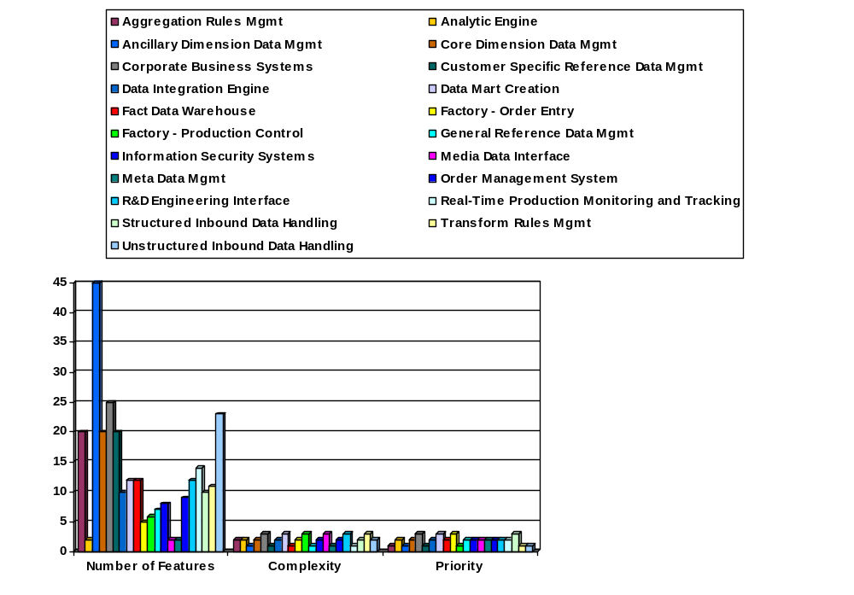
Measure of Production - Example

Slide 25
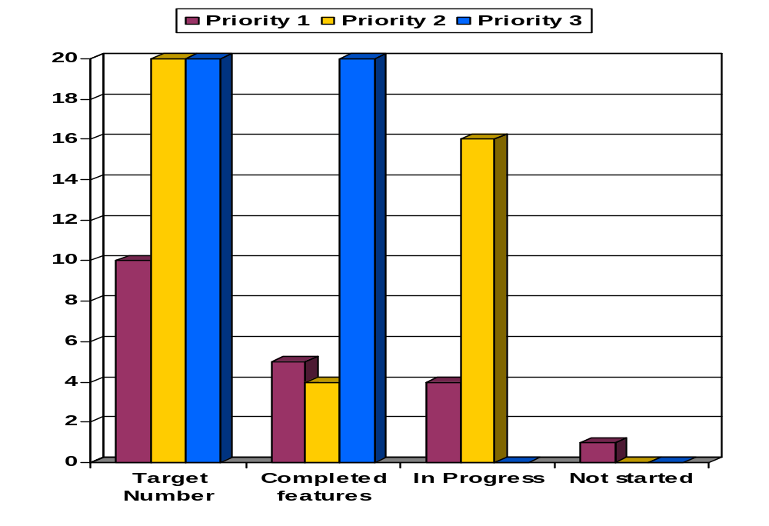
Measure of Production – Media Data Interface - example

Slide 26

Requirements Project Plan
Factory FrameWork Requirements - Iteration 2 - 2,884 hrs $258,965
New Product requirements - Iteration 2 - 1,229.6 hrs $113,221
-------------
$372,186
See attachment for more details

